Slide 1
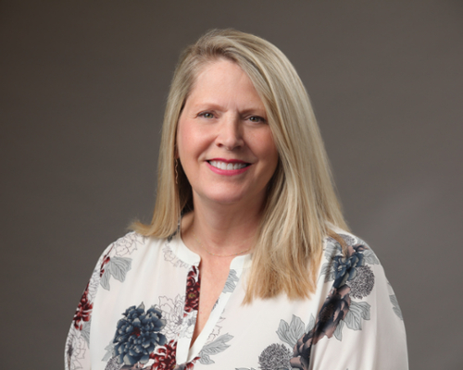
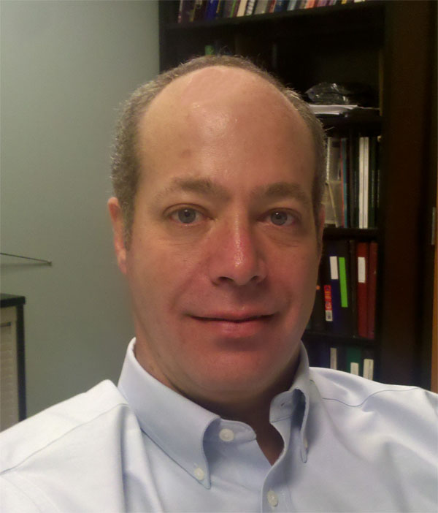
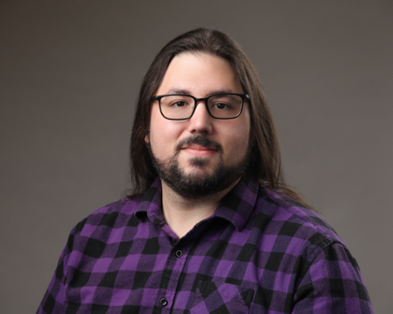
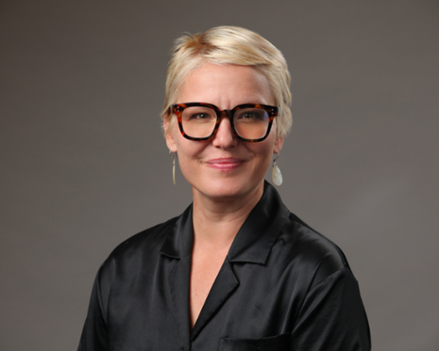
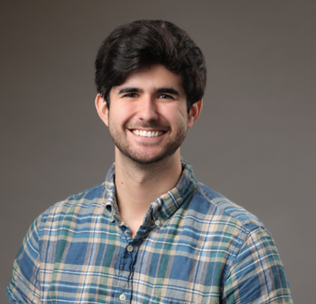
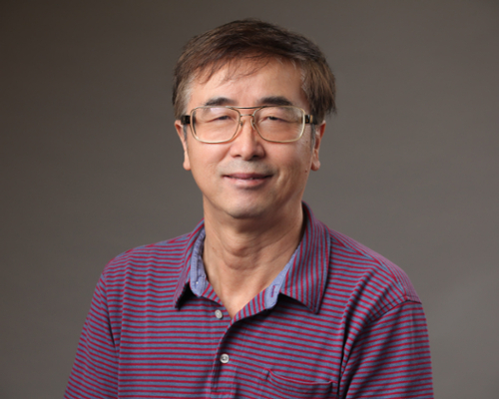
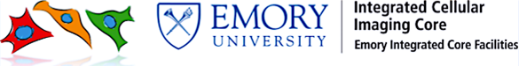
How to Take a Quantifiable Image
Mike Koval
PhD​
Stoyan Ivanov
MSc​
April Reedy
PhD​
Hunter Hakimian
PhD​
Mark (Shaojin) You
PhD​
Laura Fox-Goharioon
Core Director​
Bioinformatics Analyst
Technical Director
Assistant Scientist
Assistant
Scientist
Scientific Director​
Website: https://www.cores.emory.edu/ici/index.html​
Email: ici@emory.edu​

Slide 2
Topics for Today
What is quantifying an image?
Scenario: You've taken an image and it's time to quantify
Pitfalls: Management and Prevention
Questions

Slide 3
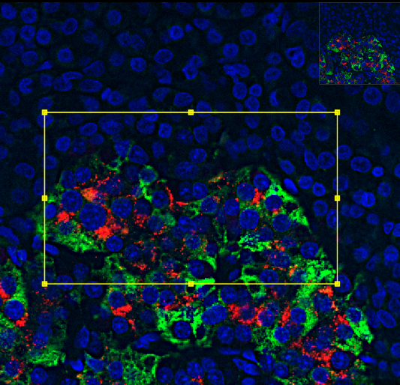
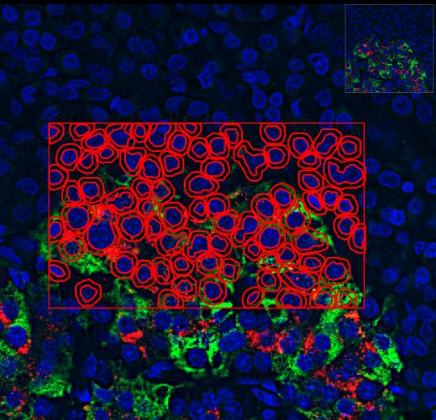
SEGMENTATION

Slide 4
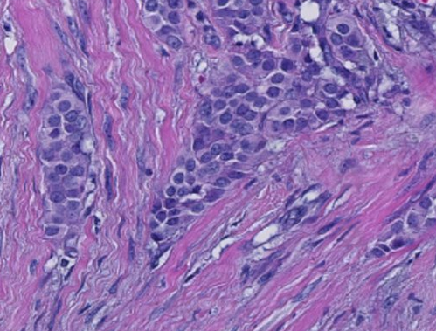
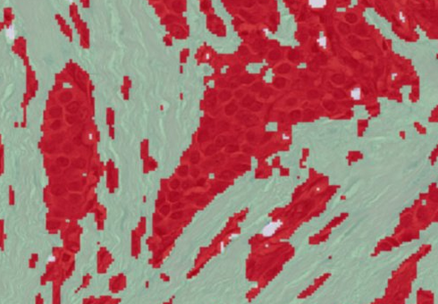
PIXEL CLASSIFICATION

Slide 5
The Biggest Culprit: File Size
What makes a file size too large
What happens when your file size is too large
How to handle large files
How to acquire smaller images

Slide 6
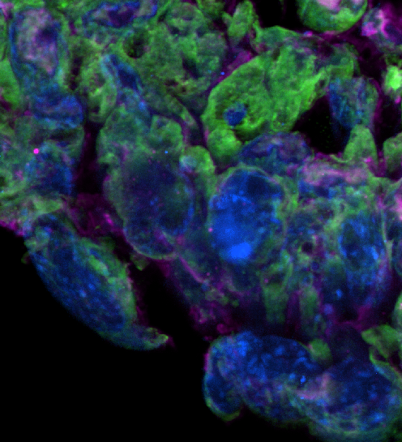
Starting Your Experiment
Let's say you want to image in high resolution a sample that is
Three channels
1 cm x 1 cm
50 microns thick
and you're looking for
examples of colocalization:
10 um

Slide 7
Going too large
Let's say you want to image your entire sample and search it in ImageJ for colocalization events
Parameters?
Resolution:
40x!
Stitch:
Entire sample!
(1 x 1 cm)
Z stack:
Full thickness!
(50 microns)
Z step:
0.2 microns!
(250 steps)
Notes:
introduction and hello

Slide 8
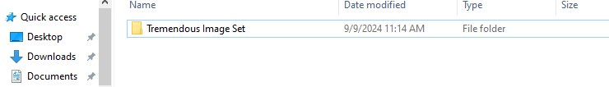


Going too large
Final total imaging + stitching time: 15.5 hours
Final total size: 161 GB
Notes:
introduction and hello

Slide 9
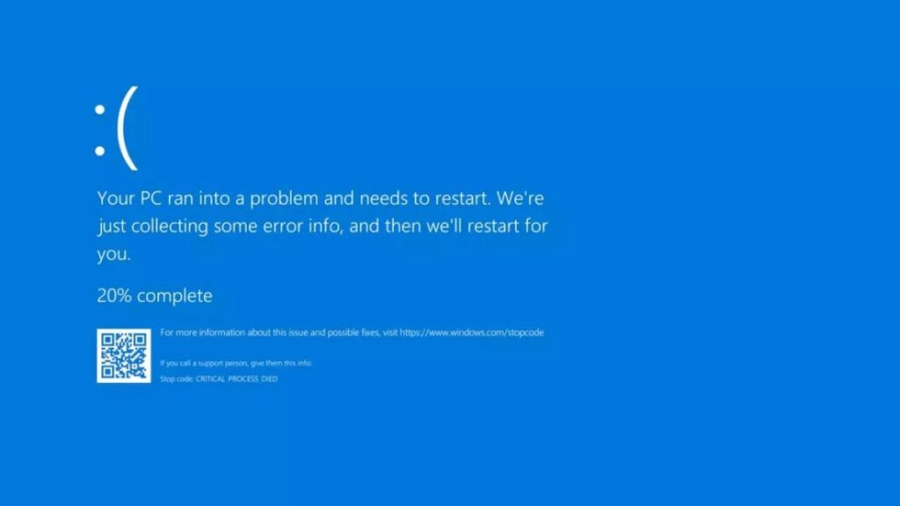

Slide 10
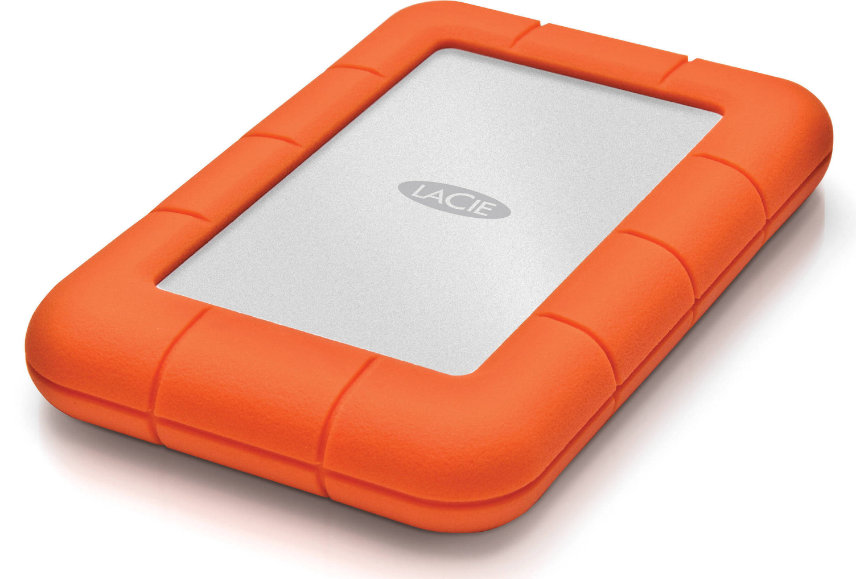
Going too large
What just happened?
The image was large, sure, but I have more than enough memory to store it, so what's the issue?
1 TB Hard Drive
161 GB Image
>
Notes:
introduction and hello

Slide 11
Going too large
Random Access Memory (RAM)
The working memory of your computer
Typically 8-32 GB installed in a computer
Whatever you have open MUST be smaller than your RAM
ImageJ can help work around this
Notes:
introduction and hello

Slide 12
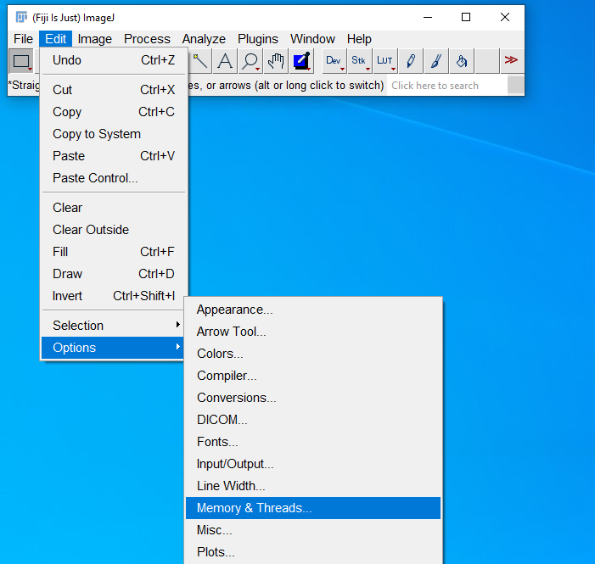
Increase the amount of RAM ImageJ Uses
Notes:
introduction and hello

Slide 13
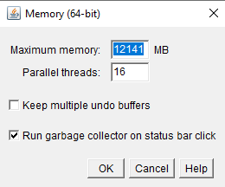
Increase the amount of RAM ImageJ Uses
Increasing maximum memory increases the size of the images you can open and manipulate
Don't go above 75% of the total RAM installed in your computer or you will have severe performance issues
Notes:
introduction and hello

Slide 14
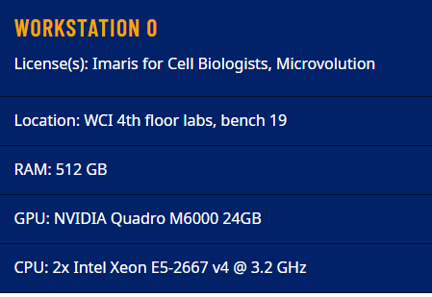
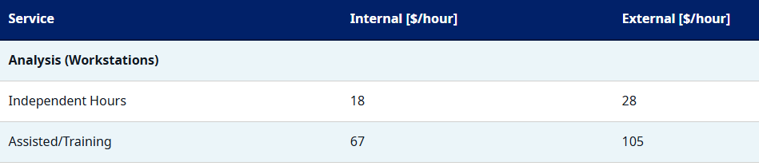
Increase the amount of RAM ImageJ Uses
"I checked and my computer doesn't have very much RAM"
Don't buy a new computer, the ICI has a solution
Notes:
introduction and hello

Slide 15
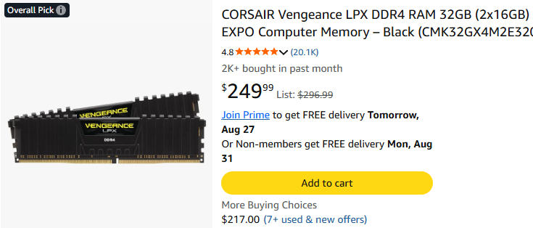
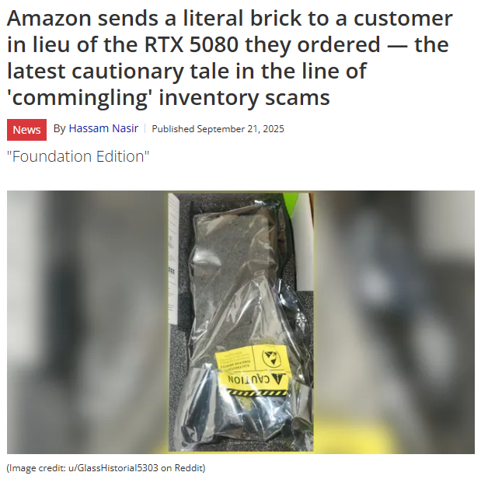
How much RAM can I get?
…assuming you don't get scammed.
~$4000 for equivalent performance in RAM…
Notes:
introduction and hello

Slide 16
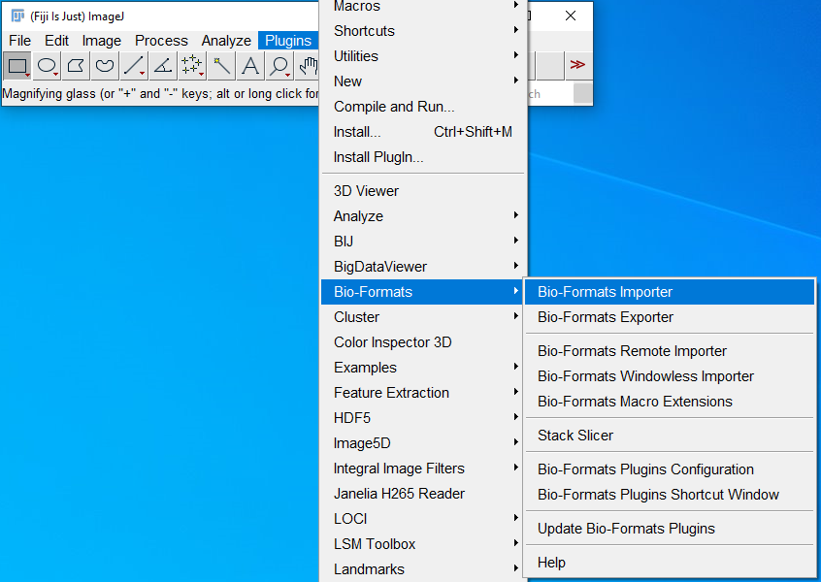
Use BioFormats (Pre-Installed in FIJI)
Notes:
introduction and hello

Slide 17
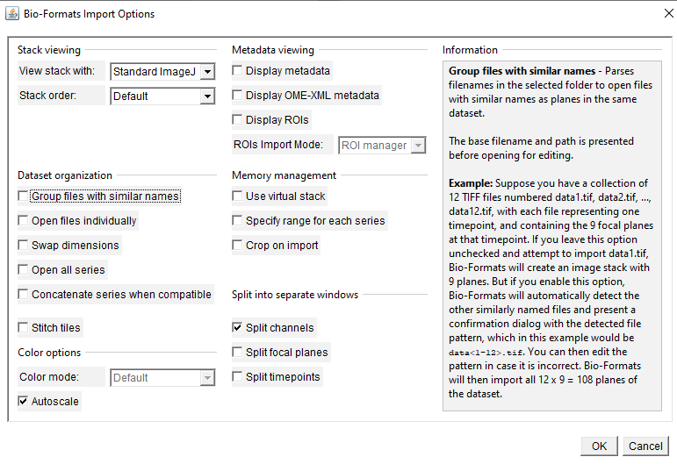
Use BioFormats (Pre-Installed in FIJI)
Notes:
introduction and hello

Slide 18

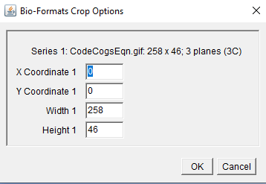
Use BioFormats (Pre-Installed in FIJI)
Notes:
introduction and hello

Slide 19

Use BioFormats (Pre-Installed in FIJI)
Notes:
introduction and hello

Slide 20

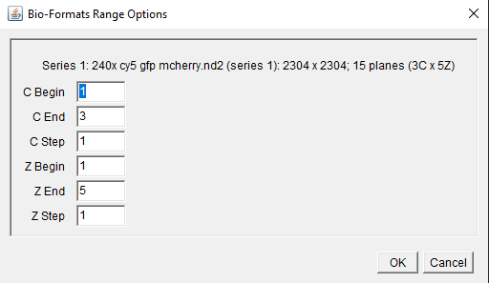
Use BioFormats (Pre-Installed in FIJI)
Notes:
introduction and hello

Slide 21
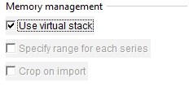
Use BioFormats (Pre-Installed in FIJI)
Loads using disk space instead of RAM
Many image edits still use RAM, so you can still crash
Prevents other two options
Conclusion: This method is best if you want to just look at your image and lack the RAM
Notes:
introduction and hello

Slide 22
Use BioFormats (Pre-Installed in FIJI)
Only open certain channels and Z-planes
Crop your image before opening it
Massively reduce file size
Notes:
introduction and hello

Slide 23
The Downside to this Method
Looking at your entire image using crops is very time consuming
Acquiring such a large image is very time consuming
You still need to store this large image
Solution?
Notes:
introduction and hello

Slide 24
Acquire Smaller, More Info-Efficient Images
Let's say you want to image in high resolution a sample that is
Three channels
Whole slide
50 microns thick
and you're looking for
examples of colocalization:
10 um
Notes:
introduction and hello

Slide 25
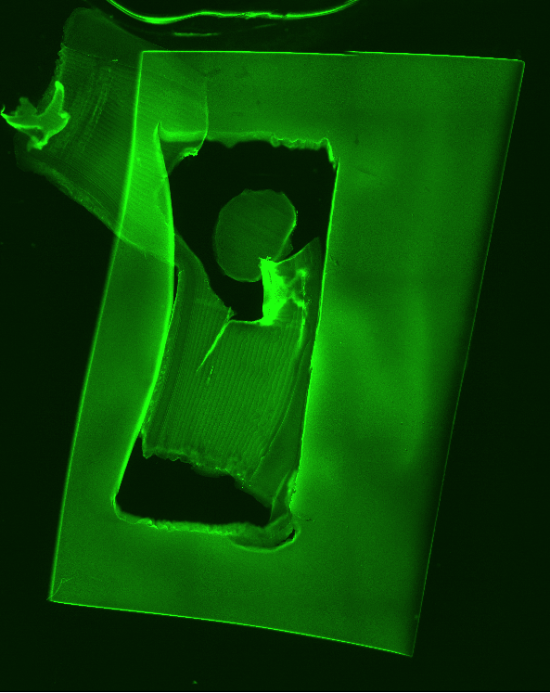
Acquire Smaller Images
Start with a navigation stitch at 1-4x
Many microscope software let you navigate using this image
Does not need to be a z-stack, as low resolution images cover a large z-depth
Can be used to find notable areas to image
Notes:
introduction and hello

Slide 26
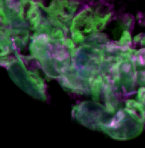
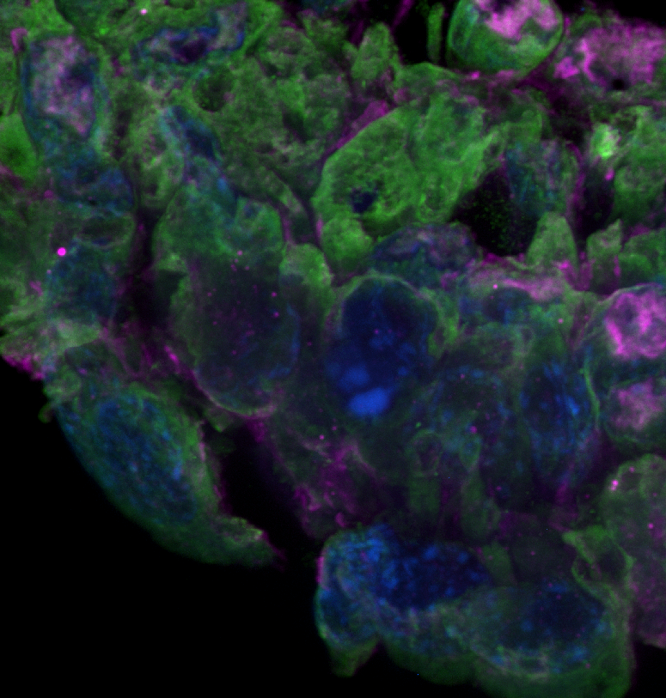
Acquire Smaller Images
Once you find an area to image, take a few test images at different resolutions
40x * 2.8x mag
= 112x
40x * 4x mag
= 160x
40x
10 um
Notes:
introduction and hello

Slide 27
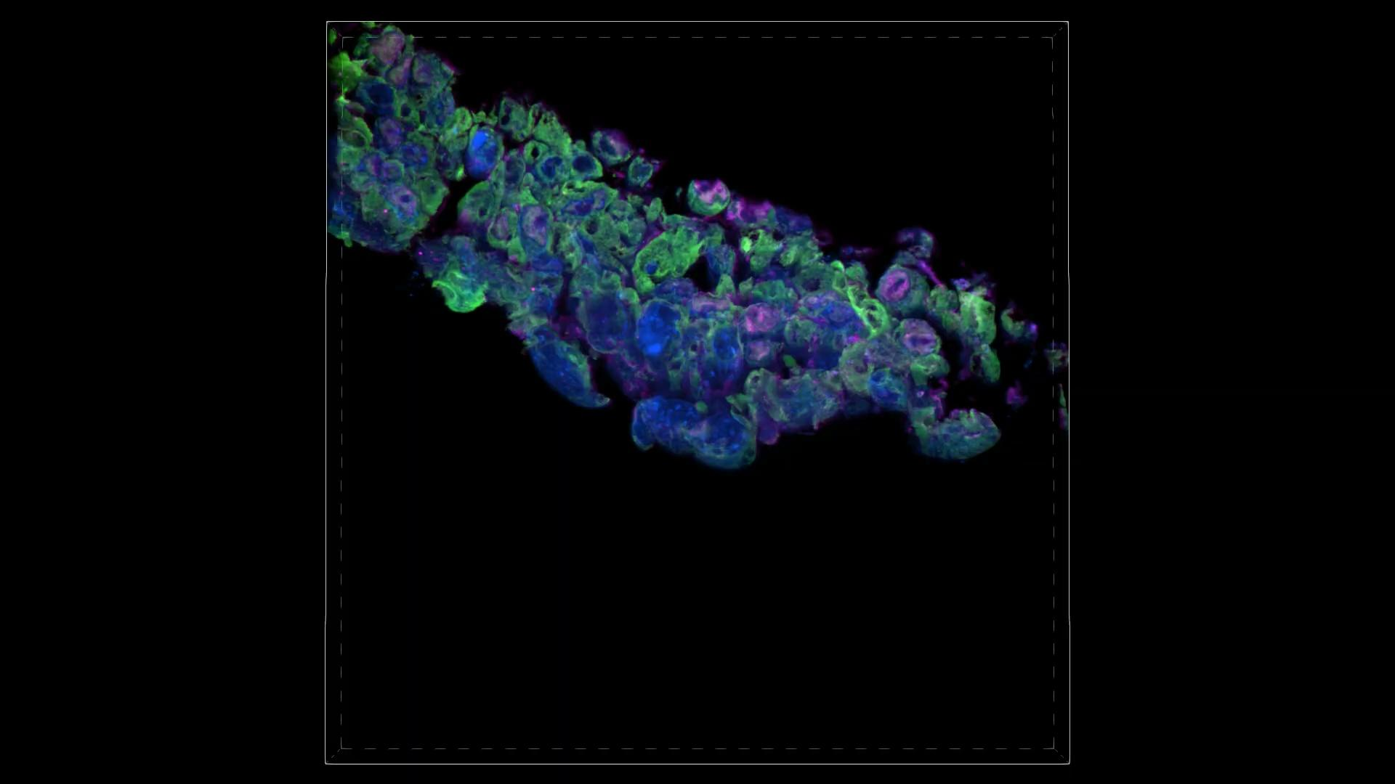
Acquire Smaller Images
Once you pick your resolution, take a Z-stack (if you need it)
Notes:
introduction and hello

Slide 28
Acquire Smaller Images
Do you need a z-stack?
Will your sample be thick enough to show multiple cell layers?
Do you need to segment all cells in a sample?
Do you need to see an interaction between two cells in different z planes?
If your answer is no to all of these, consider omitting the z-stack step
Notes:
introduction and hello

Slide 29
Acquire Smaller Images
How many steps does your z-stack need to be?
Do you want to see a few sample planes?
  Sparse
Do you need to make a full 3D structure?
  Use the recommended step size for your machine and objective
Do you want to deconvolve your image?
  Use half the recommended step size
Notes:
introduction and hello

Slide 30
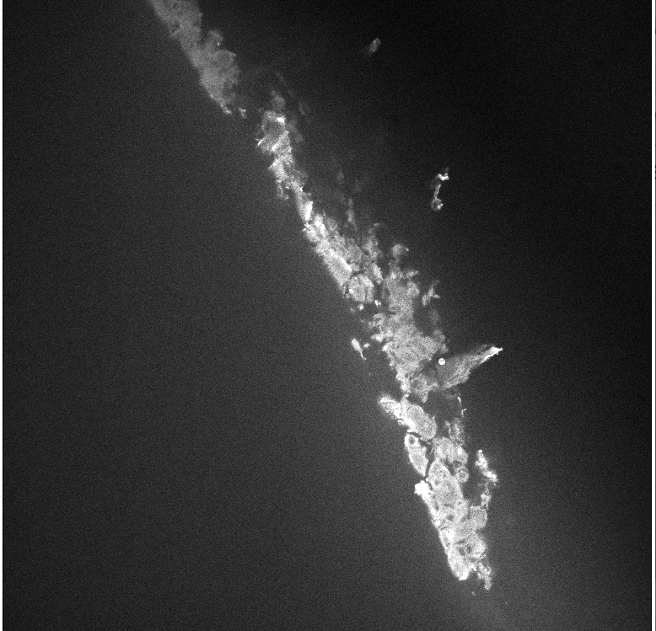
Stitching
Biggest Data Sink: Stitching
60x Image
250 x 250 microns
This image is roughly 31 megabytes.
So if I wanted to image a 2 cm x 2 cm space, it would be...
198 GB!
Notes:
introduction and hello

Slide 31
Stitching
So, how do I stitch at high resolution?
Don't image a large area
As a rule of thumb, keep your stitches below 100 images to start
Notes:
introduction and hello

Slide 32
Live Cell Applications
Remember our previous cost of the going too large?
"Final total imaging + stitching time: 15.5 hours"
This is felt the most during live cell applications
Over a long time frame, cells will drift
Movies/time-series taken will have horribly low framerate
Oil will be spread thin by stitches
Notes:
introduction and hello

Slide 33
Final Workflow to Avoid Large Datasets
There are a lot of tips here, but to simplify
Determine what kind of images your experiment needs
Start at low resolution, then increase resolution to suit your needs
Keep your stitches at low resolution
Keep your z-stacks at mid to high resolution
Use memory management tools in BioFormats as needed
Notes:
introduction and hello

Slide 34
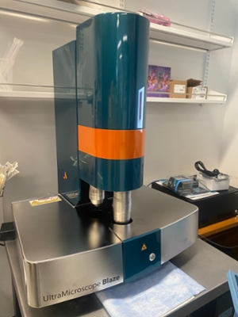
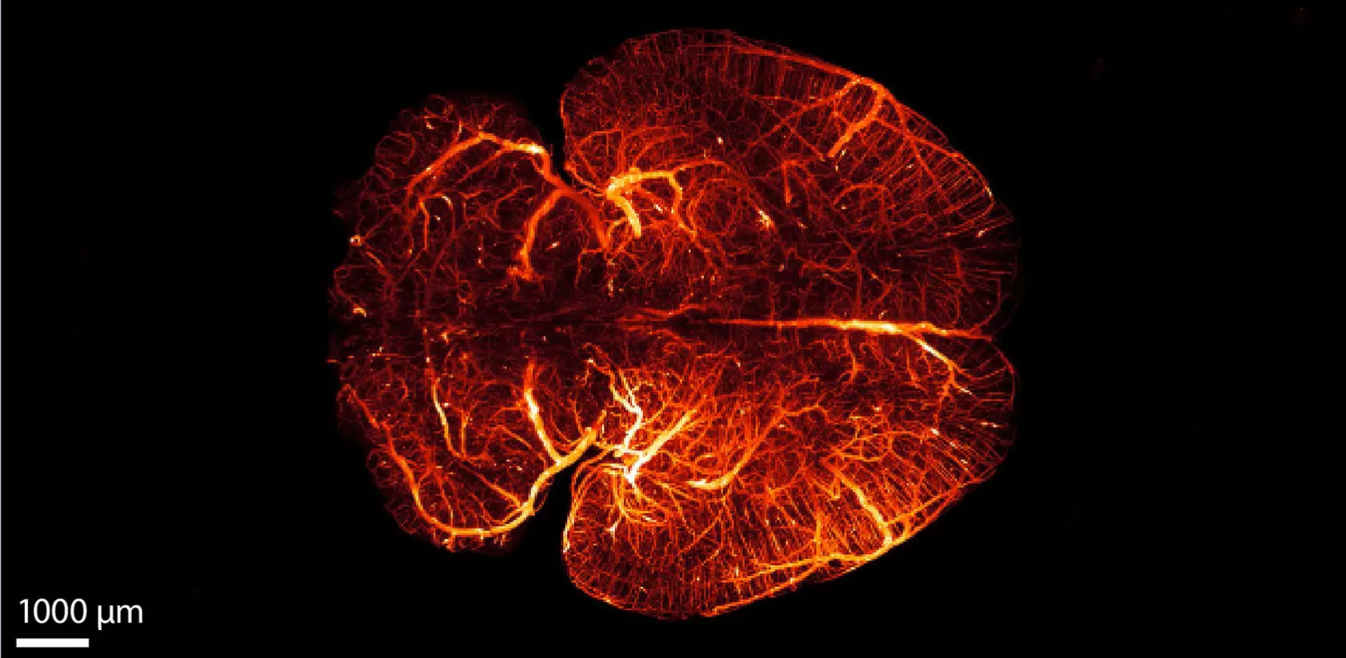
When the large stitch is unavoidable
Lightsheet!
Notes:
imaged in 7 minutes
whole mouse brain

Slide 35
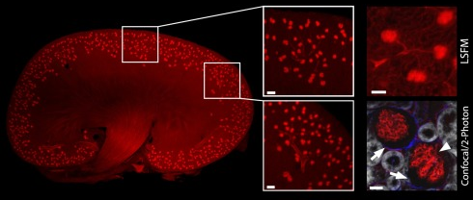
How does this compare to confocal imaging?
What is your priority?
Notes:
Imaging speed goes to lightsheet
resolution goes to confocal

Slide 36
Final Thoughts
How do you take a quantifiable image?
BEFORE YOU TAKE YOUR FULL DATASET
Take an image
Try to quantify it
Ask yourself how you wish you imaged it
Ask Stoyan and I how we wish you imaged it
Notes:
workstations hourly cost note
- compare to current cost of ram

