Slide 1
Getting the Most from Your ICI Microscopy Core
Laura Fox-Goharioon, Core Director

Slide 2

What else, beyond the microscopes, can the ICI core do for you?
ICI offers so many other resources for your research from letters of support to deeper image analysis trainings.
Educational courses
Assistance with writing methods for imaging, etc.
just to name a few. Let’s dig deeper……

Slide 3
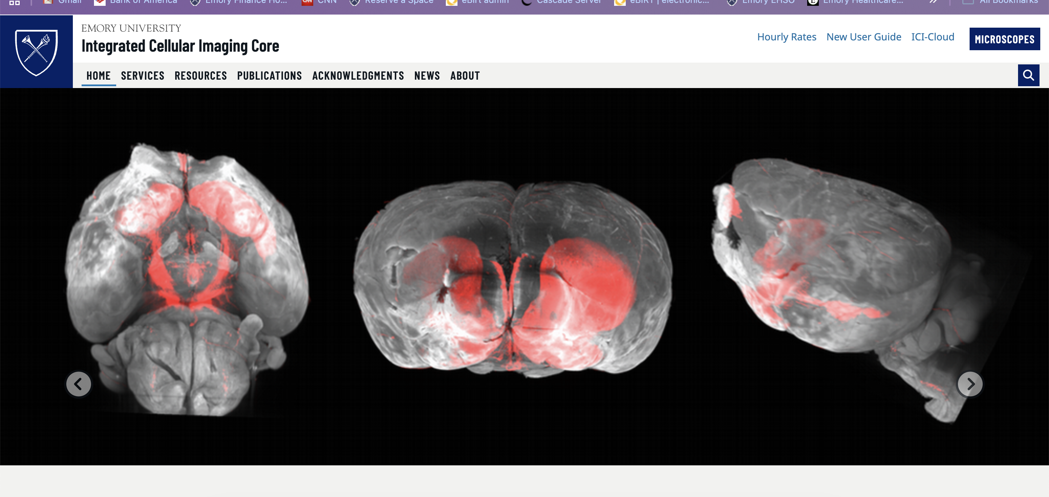
https://www.cores.emory.edu/ici/
The website is your go-to for everything you need

Slide 4
Our current rates, everything a
new user needs to know, and
how to access the ICI cloud
to retrieve your saved data.
Here you can find all our services,
microscopes as well as image analysis. Resources such as
information for grant support, protocols or FAQ's.
The acknowledgements required for the S10 equipment if you
utilized it in your studies, any news from the core and who we are.

Slide 5
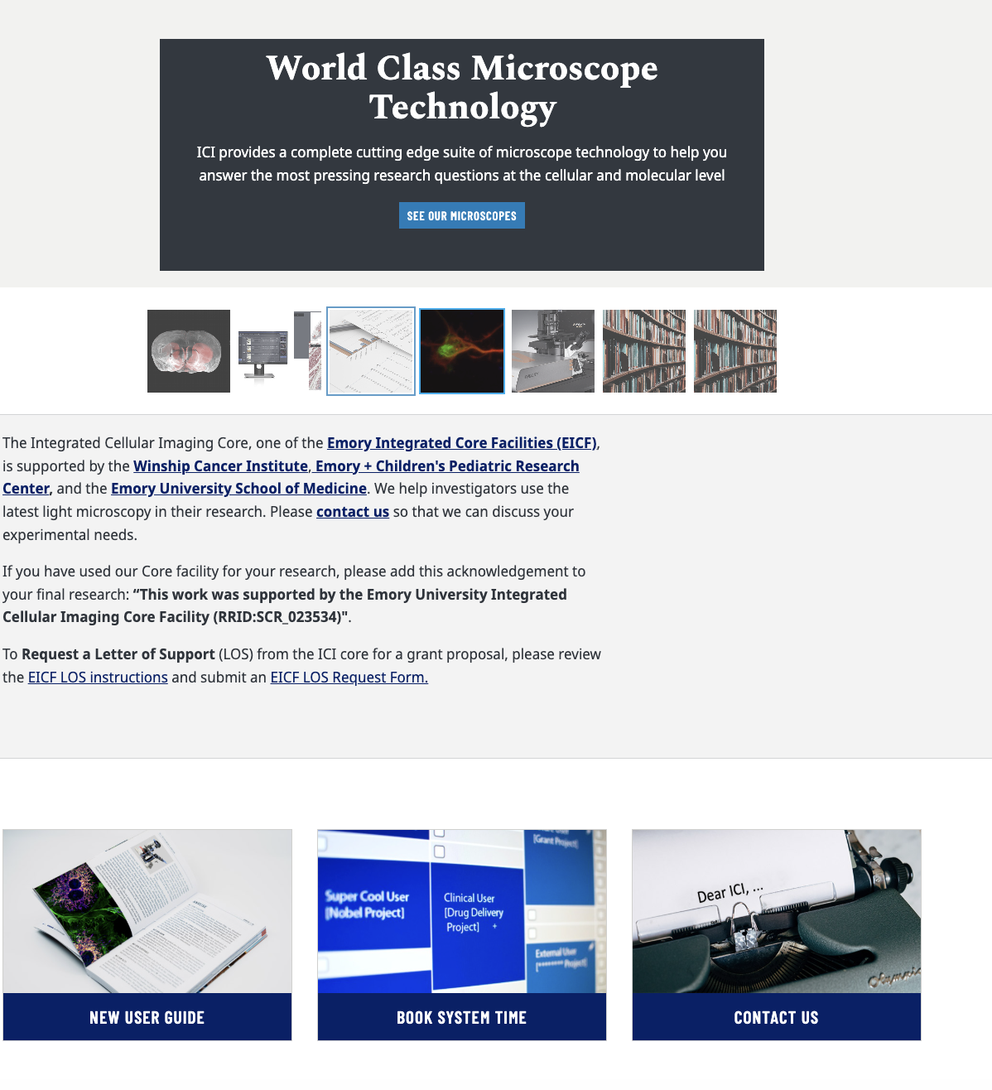
On the home page you can find how to
contact us, access PPMS to book and
information for new users.

Slide 6
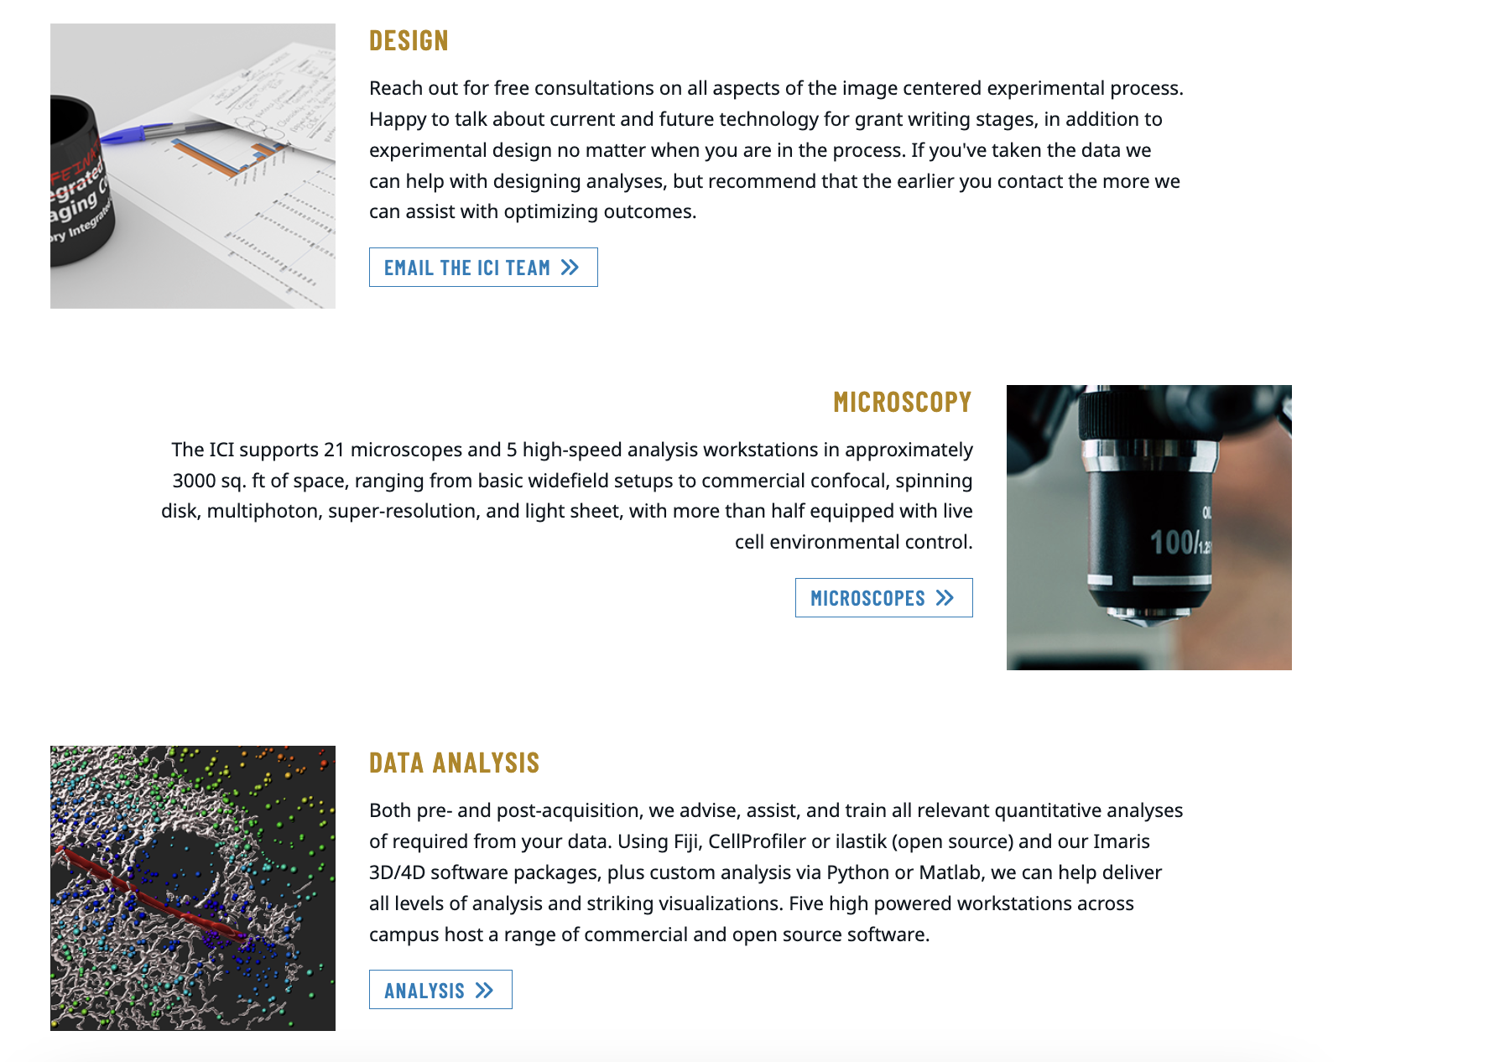
Here you can find information about our consultations
a link to the microscope pages
How to start your image analysis and our workstations

Slide 7


Slide 8



Slide 9
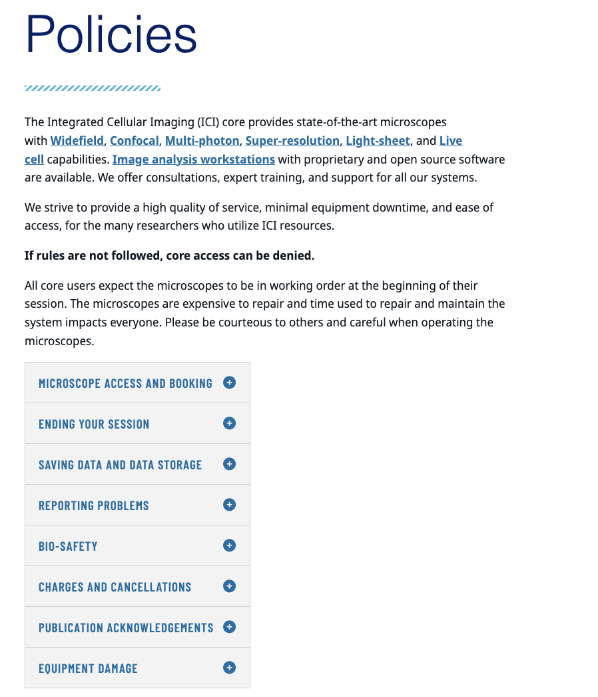
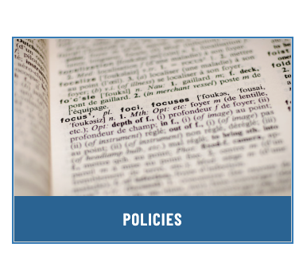

Slide 10
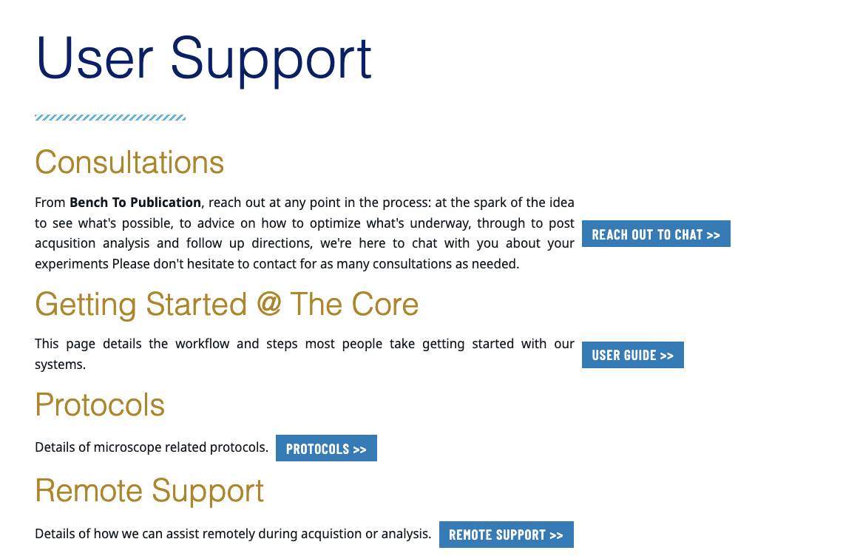


Slide 11
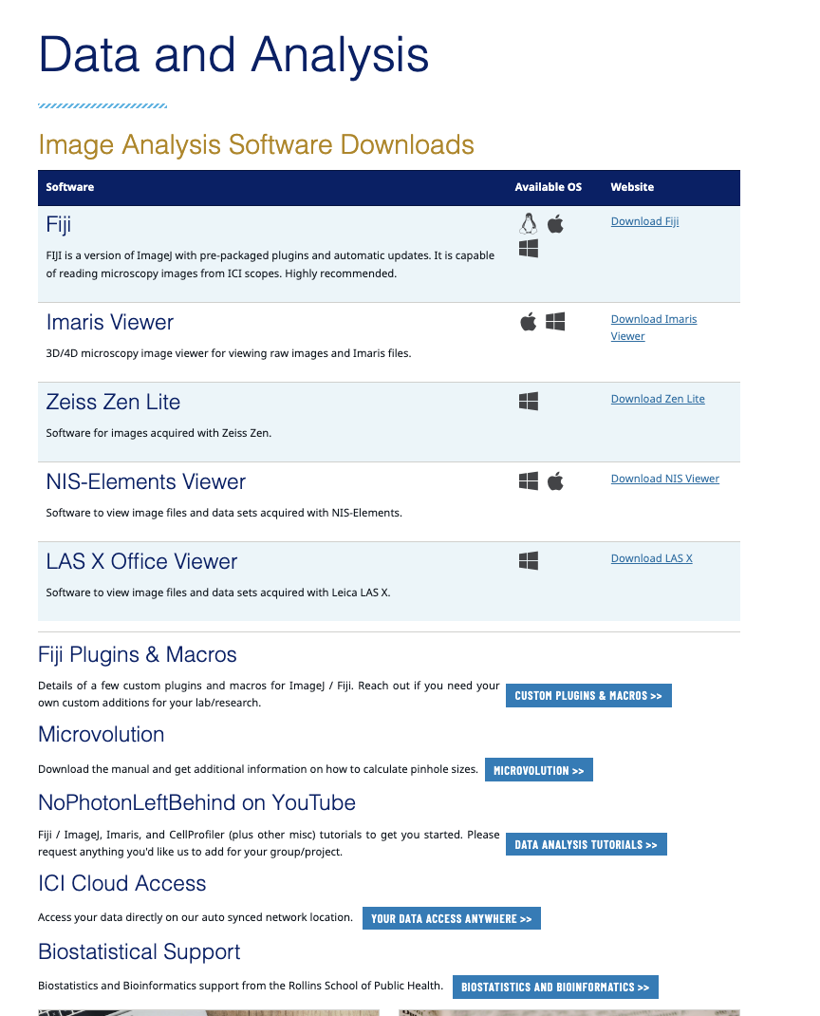


Slide 12
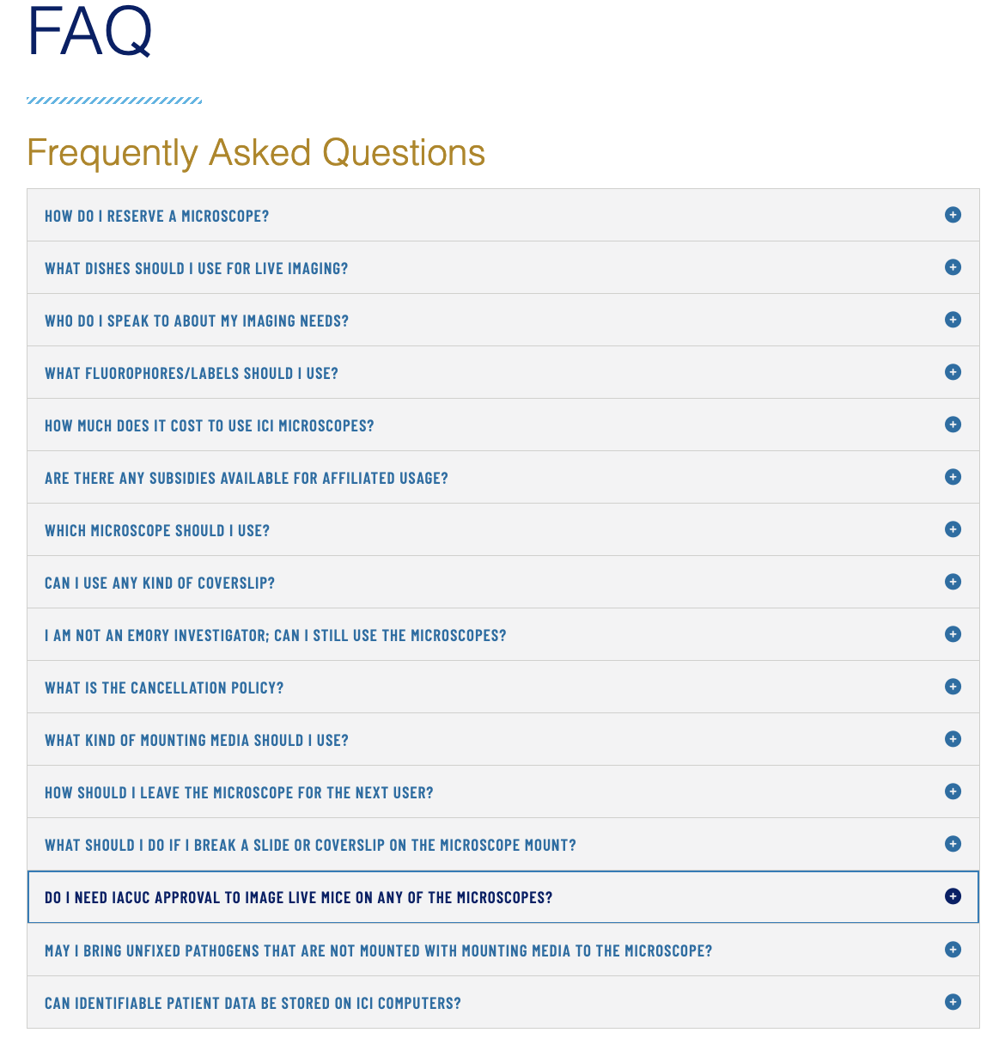


Slide 13

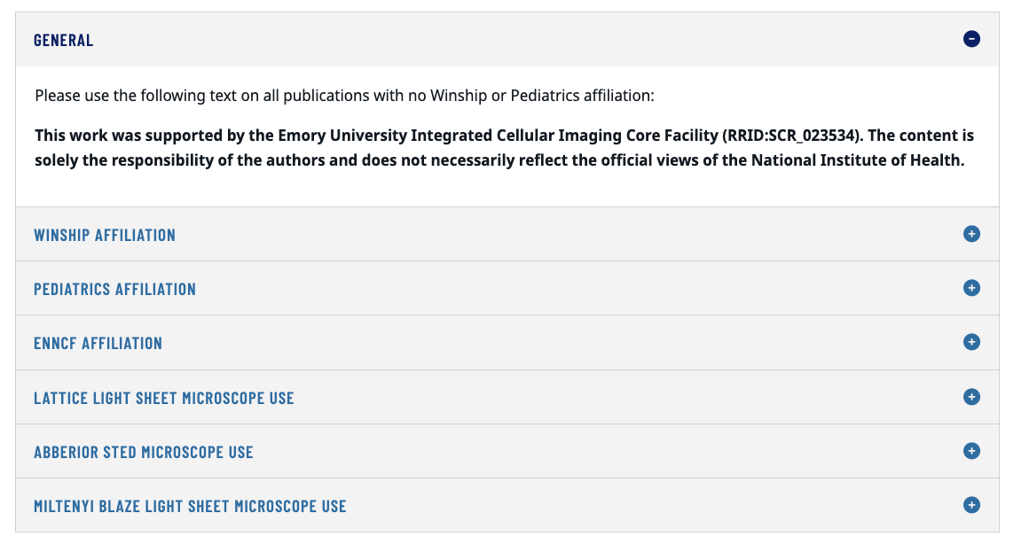

Slide 14
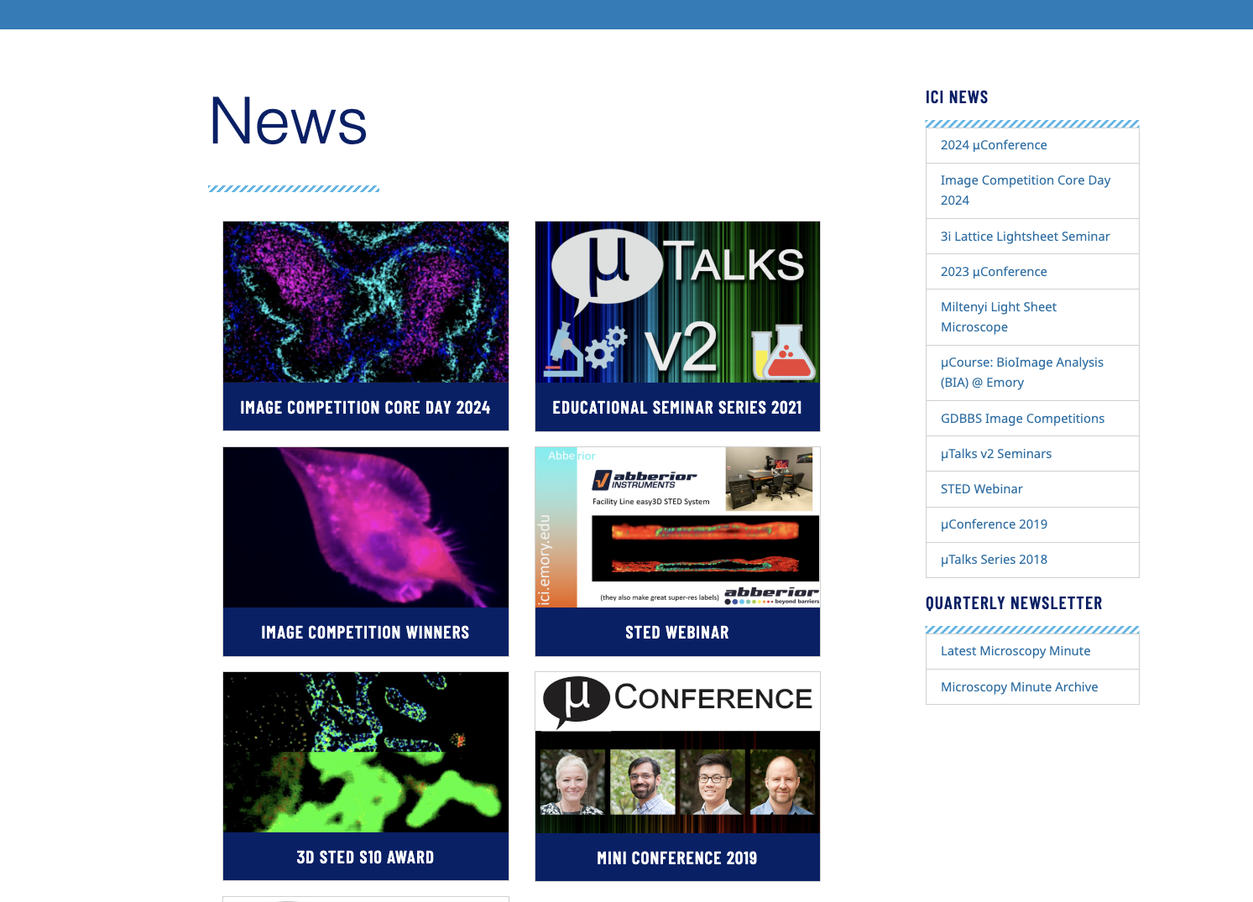

Slide 15
Further needs?
Always reach out to us! We are here to help!!

Slide 16
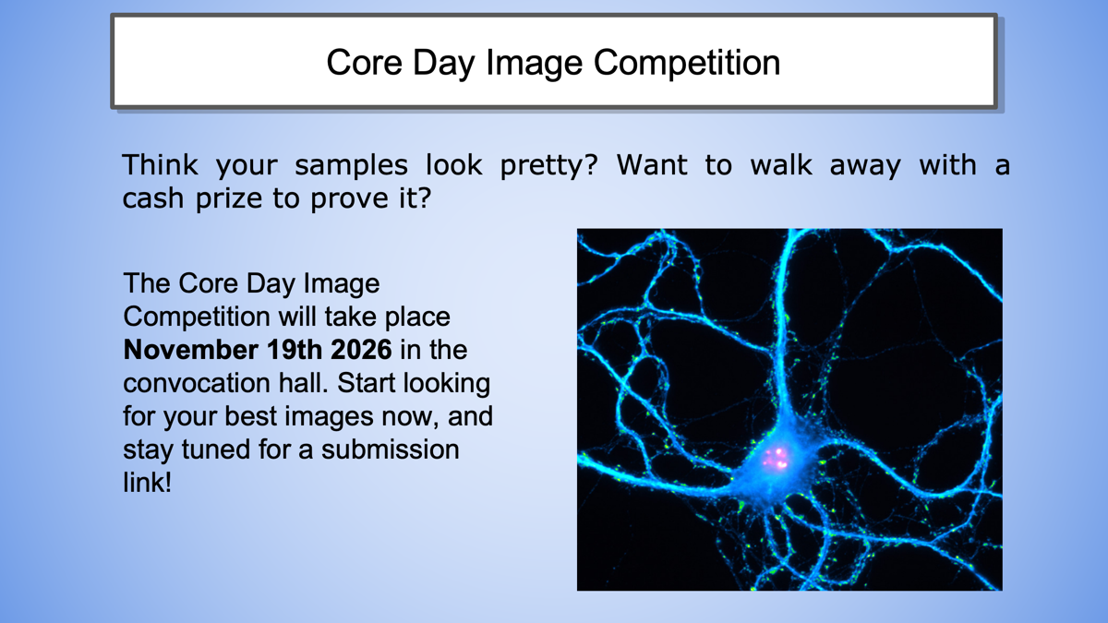

Slide 17
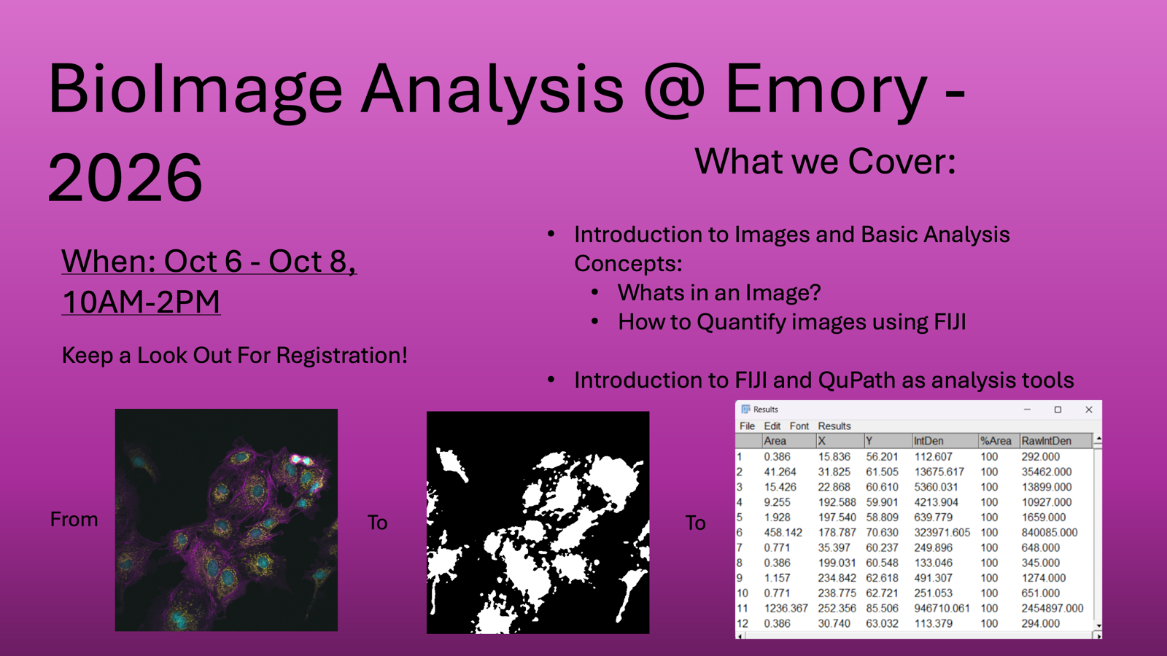

Slide 18
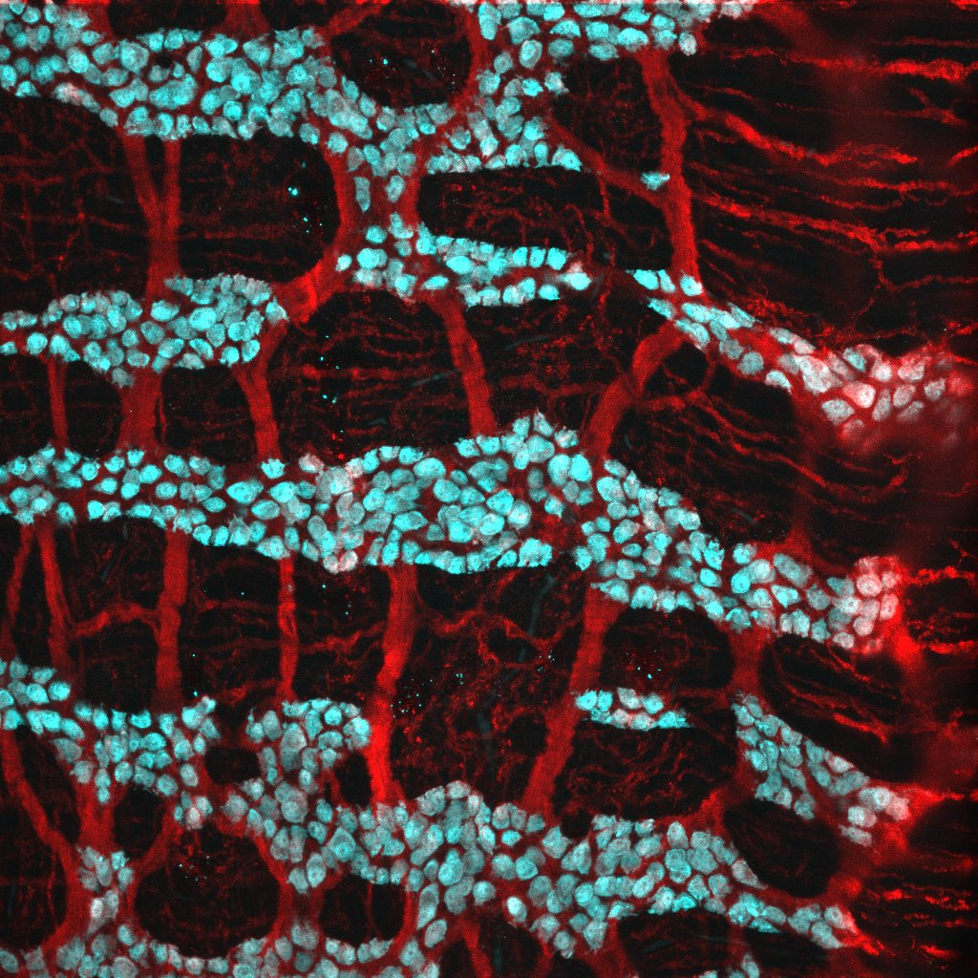
Thank you for joining us today!!
Further questions?
Sean Kelly

